Slide 1
AI based motion control 2 or 3 UAVs path planning
10.29 Jin Lexuan

Slide 2
Basic step of planning path for 2 UAVs: 1.find path for the first UAV 2.set the first path as obstacles 3.find path for the sencond UAV 4.draw trajectory for 2 UAVs Further Repeat the steps below,it can plan path for more UAVs (3,4,5...) and draw trajectory

Slide 3
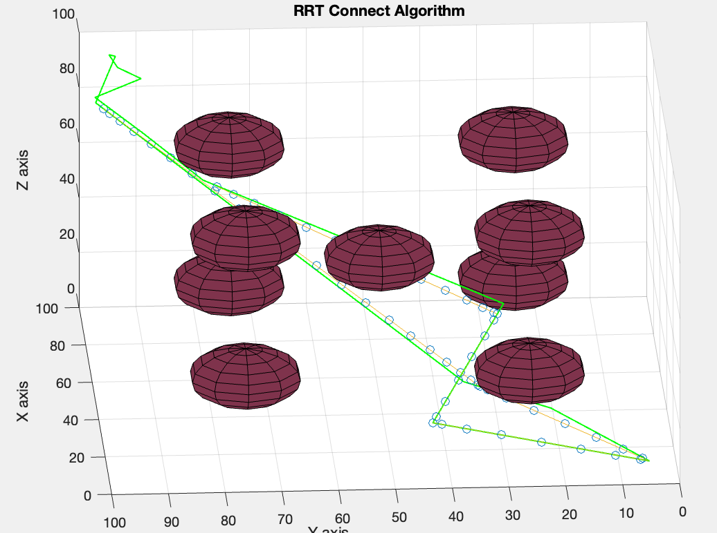
Draw 2 trajectory

Slide 4
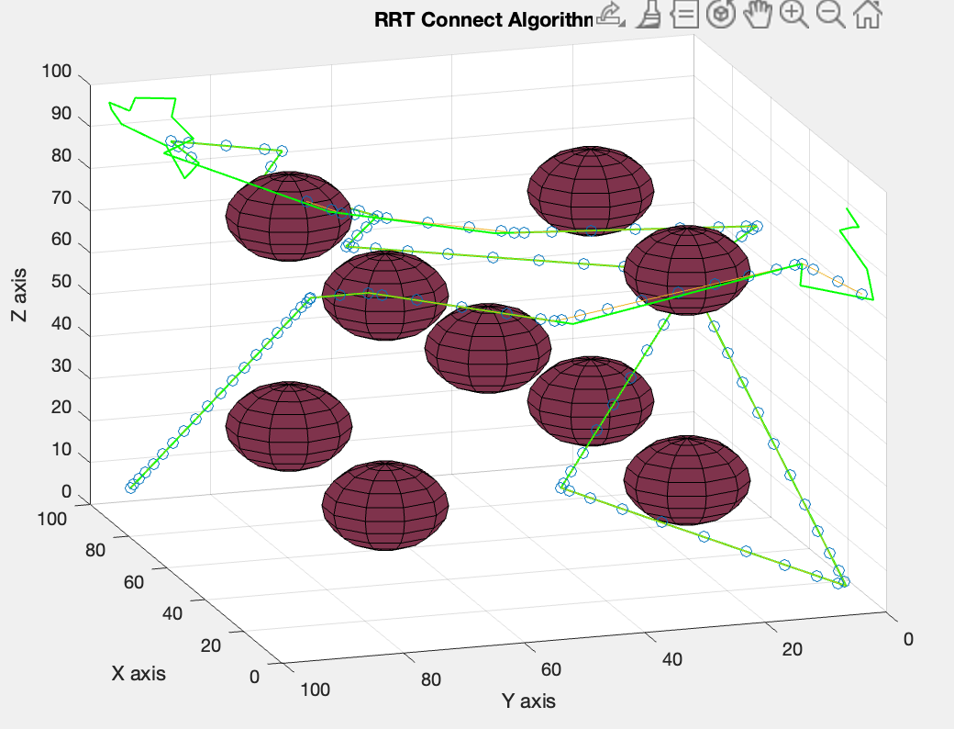
Draw 2 trajectory
Path1 and path2 has same start position and end position
Path3 diffrent from path1 and path2

